Slide 1
Tentative for a local GWL model for Indonesia Peatlands
---
Statistical Analysis

Slide 2
Field data
88 stations:
~39k samples
removing nans → ~30k samples
manual outlier removal → 27k samples
coinciding S1 imagery → 2533 samples
25 stations after qualitative pre-selection
Correlation with pysmm product
Timespan covering as many dates as possible and trying to include wet and dry periods
Try to avoid stations where field data (red line) seem to be faulty or not reliable
Try to “visually” select those stations with similar trends, i.e. matching peaks and valleys between simulated and field data
→ 1002 samples

Slide 3
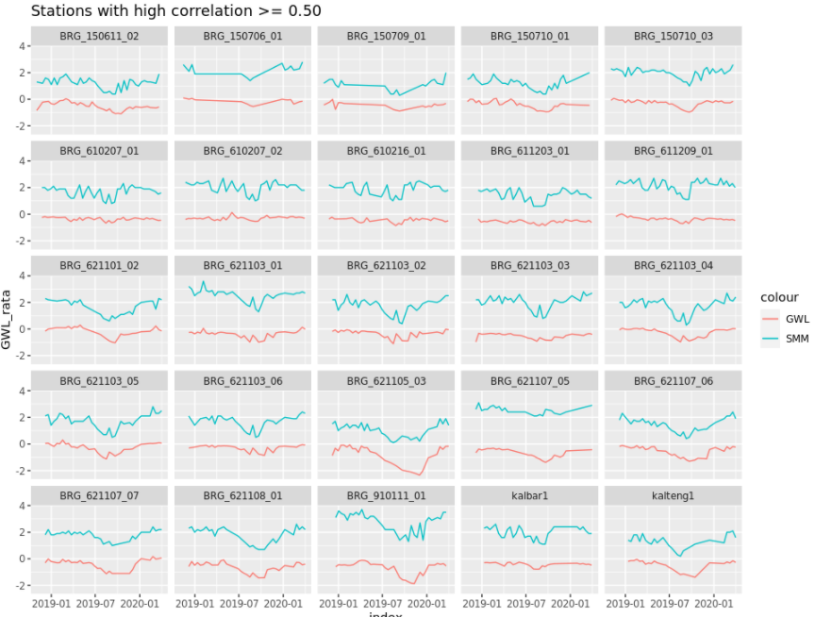

Slide 4
Satellite and Model data – predictors of GWL
Predictors used by:
- pysmm & GWL model
- GWL model only
- Temporally dynamic
Sentinel-1 (mt-speckled filtered, terrain flattened)
VV, VH, VV/VH ratio (in dB)
mean, SD, p5, p95 (in power) for same track over full S1 time-series for VV and VH
mean, SD, p5, p95 (in log) for same track over full S1 time-series for VV and VH
orbit direction
incidence angle, local incidence angle
GLDAS – Global Land Data Assimilation System:
Daily soil moisture (upper 10cm)
Cumulative soil moisture for 3, 7 and 30 days (upper 10 cm) before measurement
SRTM 30m DEM
Elevation, aspect, slope
GPM – Global Precipitation measurement
Daily precipitation (coinciding with field measurement date)
Cumulative precipitation for 3, 7 and 30 days before measurement
Landcover
Globcover classes
Total = 34 predictors

Slide 5
Modelling GWL First model assessment
Model:
Random Forest Regressor (250 estimators)
Data:
25 pre-selected „quality“ stations
Assessment:
„leave one station out“ cross validation on „quality“ stations
i.e. train on 24 and test model on the remaining one station
test on the 63 remaining stations not used for training at all
i.e. train on the 25 „quality“ stations, test on each of the remaining 63 stations

Slide 6
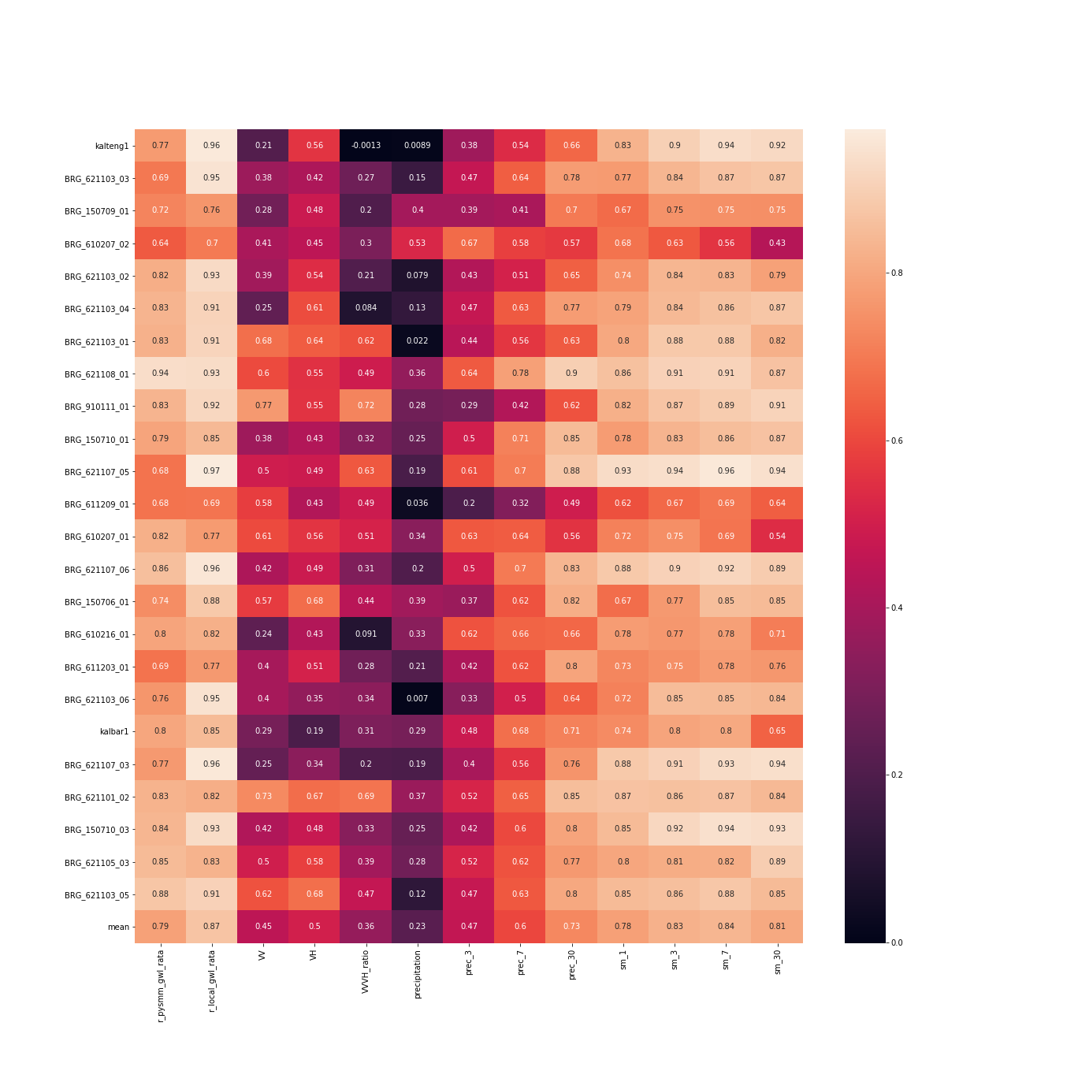
Results „leave one station out“
Mean correlation SMM -> GWL: 0.79
Mean correlation GWL model -> GWL: 0.87
Most correlated preditors are the low-res data

Slide 7
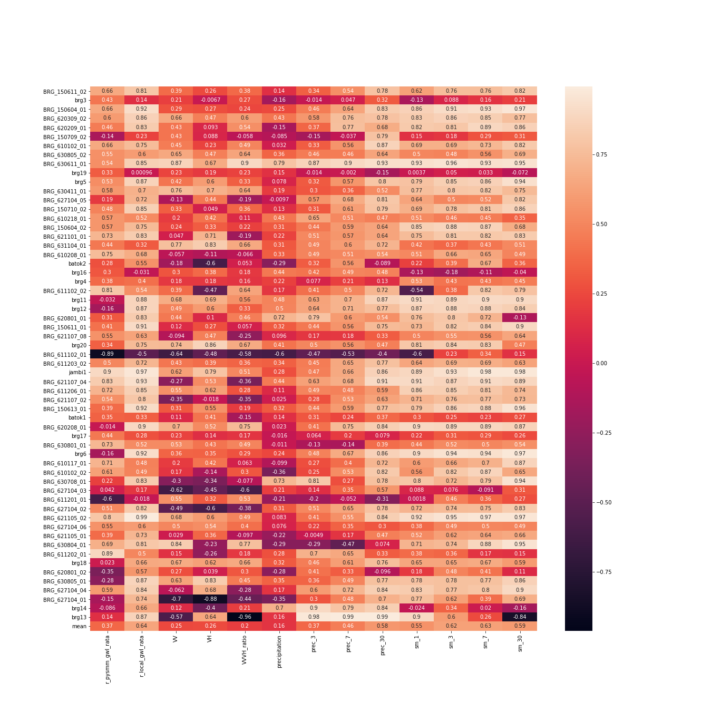
Results remaining stations
Mean correlation SMM -> GWL: 0.37
Mean correlation GWL model -> GWL: 0.64
Poor performing stations are where low-res predictors are badly correlated as well
Additional selection of 46 stations that have an r > 0.5 for final model creation

Slide 8
Modelling GWL Final model assessment
Selection of 4 models based on first model assessment
Model 1: 25 „quality“ stations
Model 2: 25 + 45 ok performing stations on test (r > 0.5 on test)
Model 3: 25 + 25 better performing stations on test (r > 0.8 on test)
Model 4: 25 + 12 better performing stations on test (rmse < 0.25 on test)
Bootstrap cross-validation for first and final model accuracy assessment
100 runs of RF model
For each run:
Randomly select 80% of the stations for train and 20% for test
Calculate pearson‘s r and rmse

Slide 9
Results
Model 1: 20/25 stations, 100 runs
Model 2: 56/70 stations, 100 runs (0.5 corr TH on 2nd test table)
Model 3: 40/50 stations, 100 runs (0.8 corr TH on 2nd test table)
 | Samples min (train/test) | Samples mean (train/test) | Samples max(train/test)
Model 1 | 722/130 | 796/205 | 872/280
Model 2 | 1618/290 | 1755/444 | 1910/582
Model 3 | 1277/242 | 1453/363 | 1575/540
 | R min | R mean | R max
Model 1 | 0.56 | 0.76 | 0.91
Model 2 | 0 | 0.41 | 0.68
Model 3 | 0.2 | 0.54 | 0.76
 | RMSE min | RMSE mean | RMSE max
Model 1 | 0.13 | 0.27 | 0.43
Model 2 | 0.27 | 0.47 | 0.74
Model 3 | 0.28 | 0.42 | 0.65

Slide 10
Results (focusing on RMSE for station selection rather than pearson‘s r)
Model 4: 29/37 stations, 100 runs, TH on RMSE < 0.25 on test table 2
 | Samples min (train/test) | Samples mean (train/test) | Samples max(train/test)
Model 1 | 722/130 | 796/205 | 872/280
Model 4 | 951/224 | 1090/307 | 1174/447
 | R min | R mean | R max
Model 1 | 0.56 | 0.76 | 0.91
Model 4 | 0.59 | 0.78 +- 0.01 (95%) | 0.9
 | RMSE min | RMSE mean | RMSE max
Model 1 | 0.13 | 0.27 | 0.43
Model 4 | 0.15 | 0.24 +- 0.01 (95%) | 0.36

Slide 11

Model 4

Slide 12
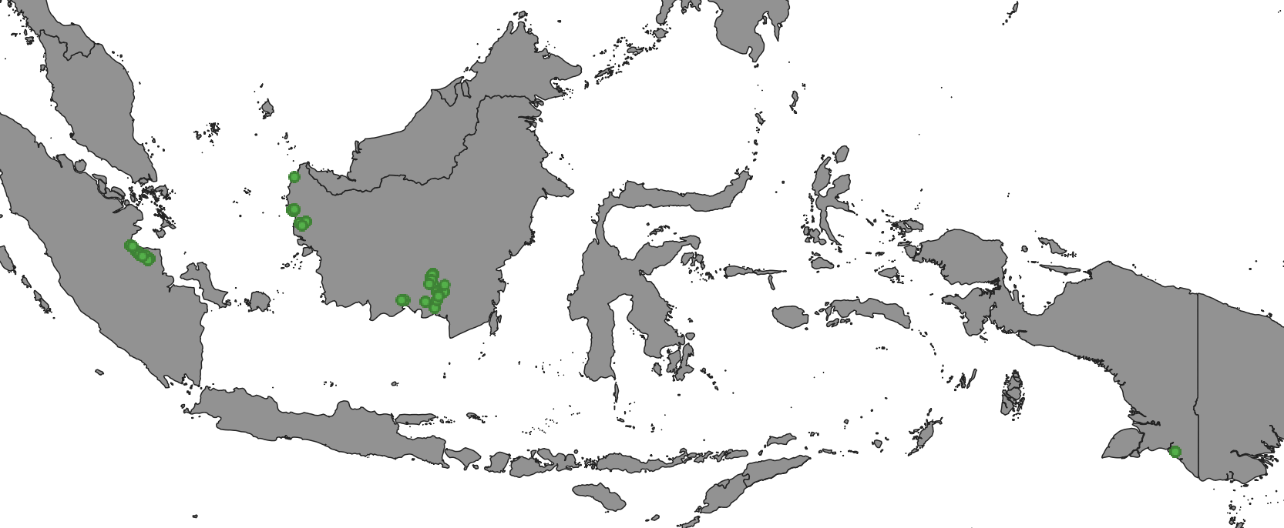
Location of 37 calibration stations → well distributed

Slide 13
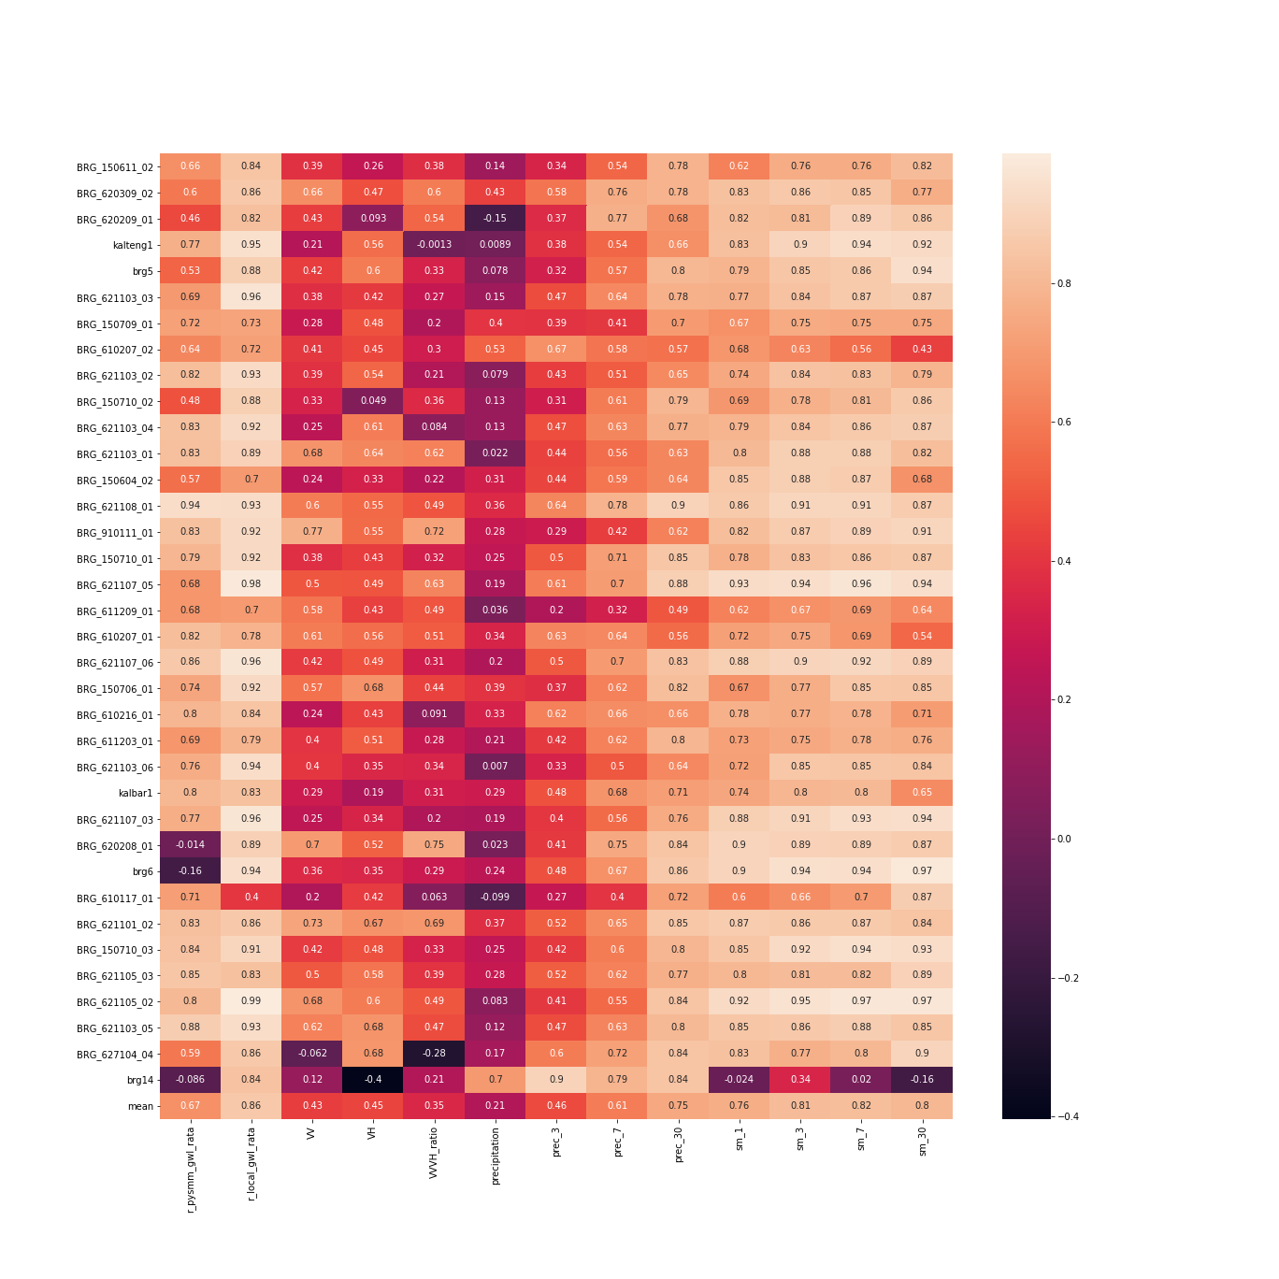
Repitition of Experiment 1 with 37 stations
Leave one station out cross-validation
Mean r = 0.86

Slide 14
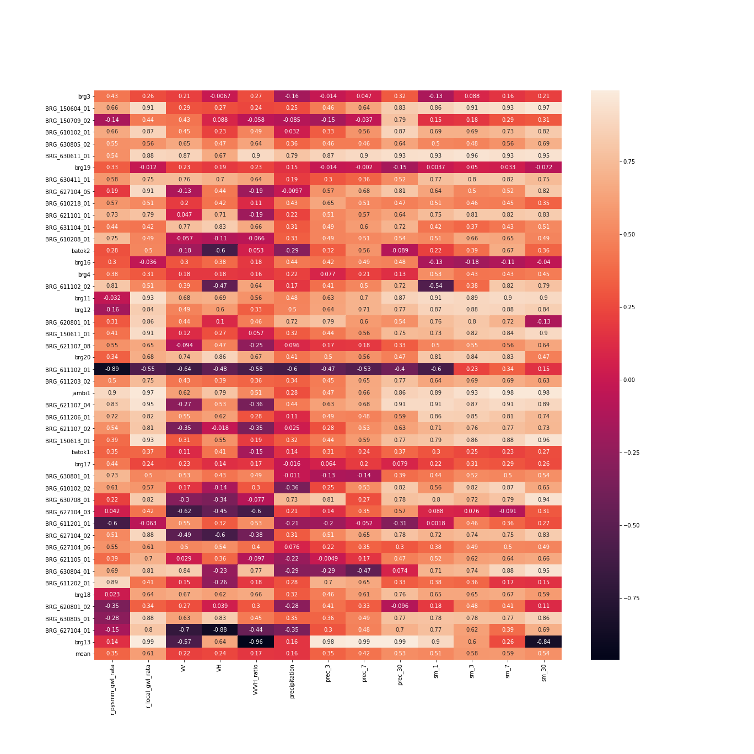
Repitition of Experiment 2 with remaining stations
Model from all 37 good stations, tested on each of the other station
Mean r = 0.61
Mean RMSE = 0.58
Possible reasons for lower accuracy:
Stations under vegetation (no sensitivity for Sentinel-1 to soil moisture)
Stations somehow do not represent the wider area (e.g. near to rivers/channels)

Slide 15
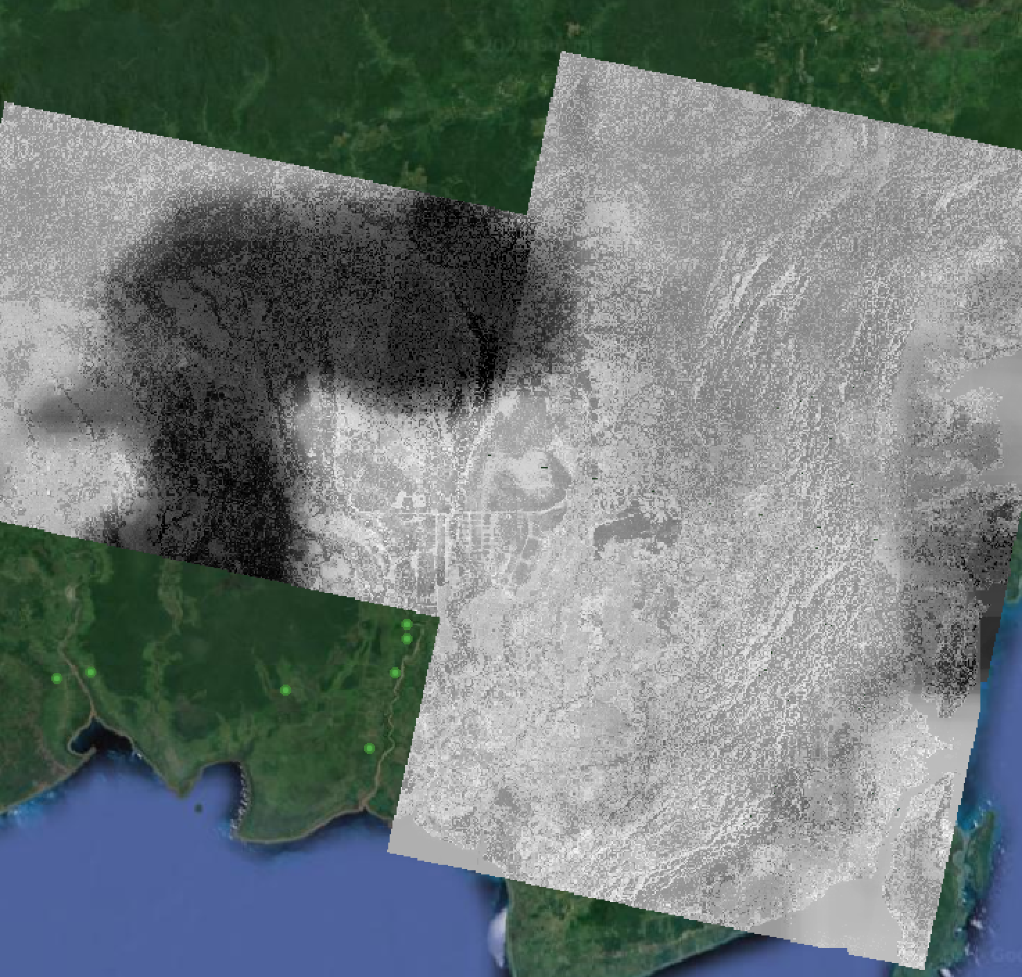
First local map
Local phenomena to understand (maybe precipitation?)
Masking of areas where S1 is limited

Slide 16
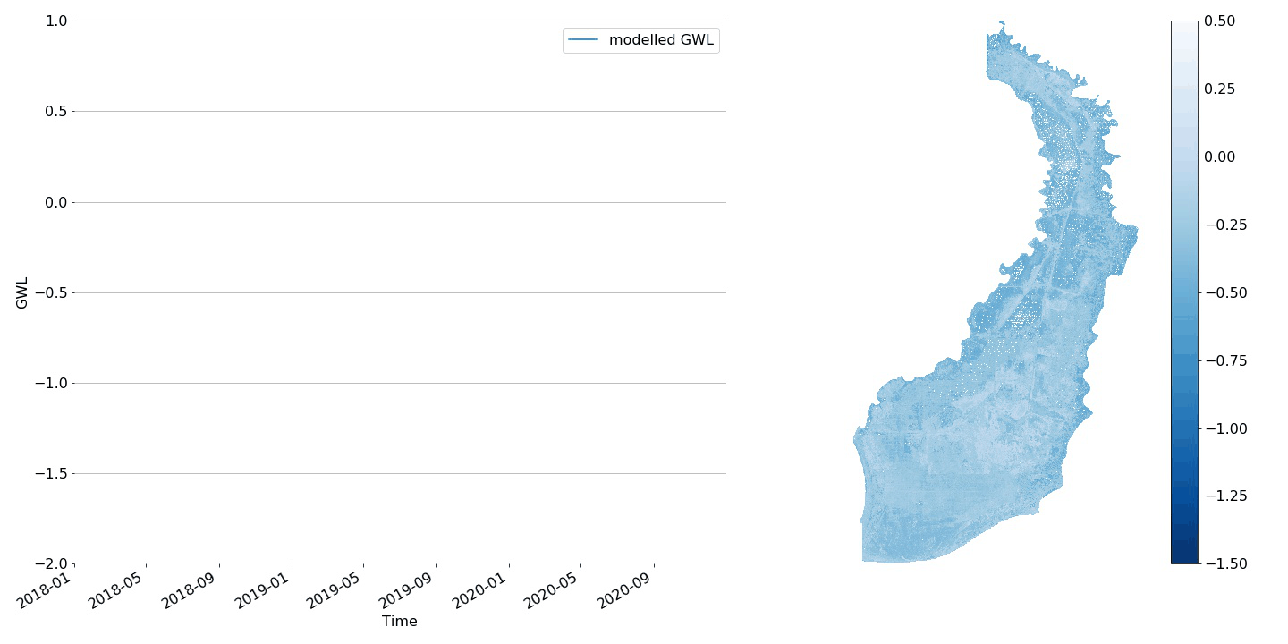
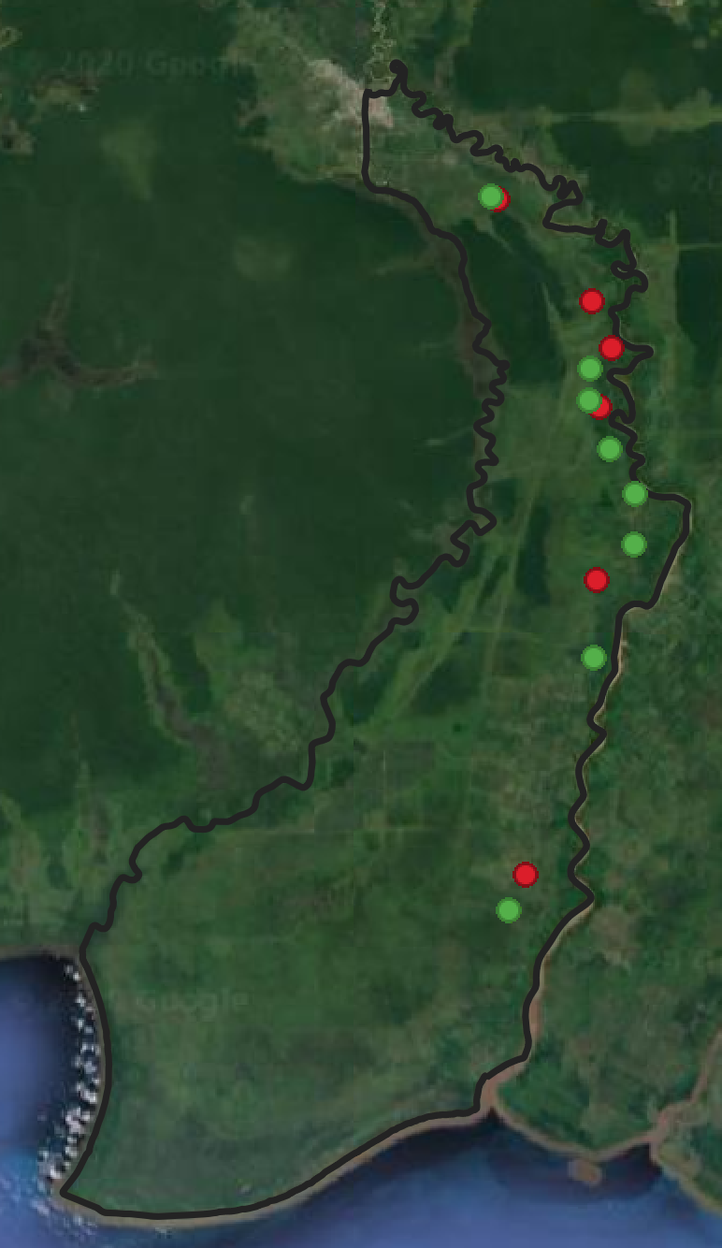
Creation of time-series on PHU level South Kalimantan – Sungai Sebangau
Time-series animation of mean values of the PHU (with 5-95th percentile area) in blue and mean values of all „good“ stations within that PHU in orange (with 5th to 95th percentile area)
Pixel-based GWL map (100m) for respective date
Location of field stations
(good & bad stations)

Slide 17
Creation of time-series on PHU level South Kalimantan – Sungai Sebangau
Time-series animation of mean values of the PHU (with 5-95th percentile area) in blue and mean values of all stations within that PHU in orange (with 5th to 95th percentile area)
Pixel-based GWL map (100m) for respective date
Location of field stations
(good & bad stations)

Slide 18
Creation of time-series on PHU level
General following trends of seasons/field data
Observation → no steep downwards trend for September 2020
When using all stations, field measurements go up → indicates stations near to rivers/channels?

Slide 19
Conclusions & Next steps
It seems possible to get a dedicated model for GWL
Difficult to assess if we are overfitting, or if station data is sometimes bad
More field data needed
Masking of areas where algorithm is not working (e.g. under densely vegetated areas)
Re-iterate model for visual assessment
Visual comparison to pysmm product
Create data for NASA/Maryland stations & let them validate
Create data for LORA stations and validate

